Slide 1

Data Structures
Week 2 - Recursion
Juan Carlos Pineda
ITESM
juancarlos.pineda@itesm.mx

Slide 2
Introduction
There are many math problems and objects that are presented by a process that defines them
One example is π is defined as the quotient of a circumference perimeter and its diameter
Another example is the factorial function
A mathematician, like a painter or poet, is a maker of patterns.
—G. H. Hardy, A Mathematician’s Apology, 1940

Slide 3
Basic Real Life Task
Search a word/concept in the dictionary or in Google
Exercise
Explain to me what necroptosis is by looking it up in Google or Wikipedia
Notes:
5 minutes

Slide 4
Counting the people in the classroom
To a student in the front row: How many students are in your side of the clasroom?
You have a poor vision so you can’t stand and count
You are allowed to ask the person next to you or behind
How can we solve this problem?

Slide 5
The Factorial Function
One of the oldest problems in Mathematics is the Factorial function.
For a given n number, the Factorial Function is defined as
n! = n * (n - 1) * (n - 2) * . . . 3 * 2 * 1
By definition 0! = 1

Slide 6

Coding time
Exercise 1. Code in C a program to calculate n! For any n ∊ ℤ
What is the complexity of your algorithm?
What is the limit of the loop?

Slide 7
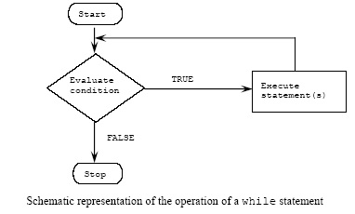
Iterative Functions
Such an algorithm is called iterative, because it requires explicit repetition of a process until a condition is met

Slide 8
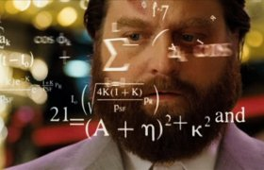
Factorial Function
Let’s look a little deeper…
Calculating n! For any number n greater than 0 is equal to doing n * (n - 1)!. Therefore this can be defined as:
0! = 1
1! = 1 * 0!
2! = 2 * 1!
3! = 3 * 2!
. . .

Slide 9
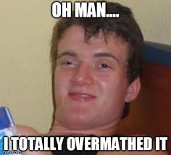
Factorial Function
Using math notation:
n! = 1 if n = 0
n! = n * (n - 1)! If n > 0
This might seem odd since the function is defined on its own terms.
Such definition that defines an object in terms of a simpler case of itself it’s called a Recursive Function

Slide 10
Recursion
A mathematician, like a painter or poet, is a maker of patterns.
—G. H. Hardy, A Mathematician’s Apology, 1940
You can use recursion to solve many kinds of programming problems that would be very difficult to conceptualize and solve without recursion.
Computer scientists in the field of artificial intelligence (AI) often use recursion to write programs that exhibit intelligent behavior: playing games such as chess, proving mathematical theorems, recognizing patterns, and so on.

Slide 11
Recursive Thinking
Definition
A recurrence relation for a sequence a0, a1, a2, . . . is a formula that relates each term ak to certain of its predecessors ak−1, ak−2, . . . , ak−i, where i is an integer with k − i ≥ 0. The initial conditions for such a recurrence relation specify the values of a0, a1, a2, . . . , ai−1, if i is a fixed integer, or a0, a1, . . . , am, where m is an integer with m ≥ 0, if i depends on k.

Slide 12
Recursive Sequence
Define a sequence c0, c1, c2, . . . recursively as follows: For all integers k ≥ 2,
(1) ck = ck−1 + kck−2 + 1 recurrence relation
(2) c0 =1 and c1 = 2 initial conditions.
Find c2, c3, and c4.
Solution
c2 = c1 + 2c0 + 1 by substituting k = 2 into (1)
= 2 + 2·1 + 1 since c1 = 2 and c0 = 1 by (2)
(3) ∴ c2 = 5
c3 = c2 + 3c1 + 1 by substituting k = 3 into (1)
= 5 + 3·2 + 1 since c2 = 5 by (3) and c1 = 2 by (2)
(4) ∴ c3 = 12
c4 = c3 + 4c2 + 1
= 12 + 4·5 + 1
(5) ∴ c4 = 33

Slide 13
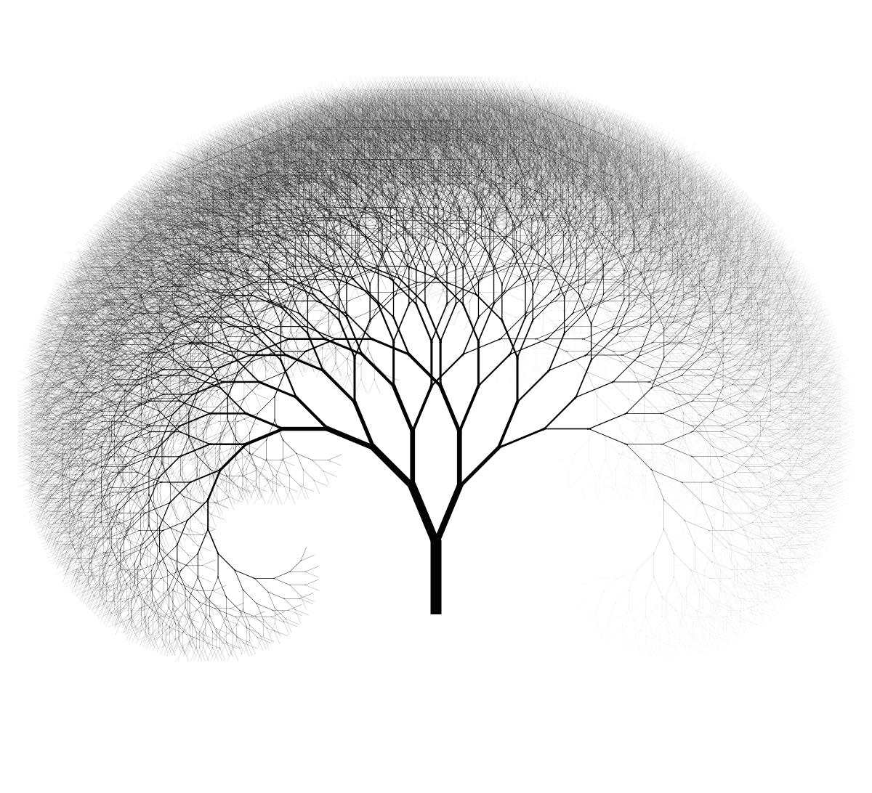
Recursion contd
Recursion is one of the central ideas of computer science.
To solve a problem recursively means to find a way to break it down into smaller subproblems each having the same form as the original problem—and to do this in such a way that when the process is repeated many times
The most difficult part of solving problems recursively is to figure out how knowing the solution to smaller subproblems of the same type as the original problem will give you a solution to the problem as a whole

Slide 14
Recursion and cases
Recursive functions have 2 cases:
Base case - The easiest case where the program either finds its logical end or an error
Recursive case: The complex case, where the program’s objective can not be reached (i.e. it has not been divided to the smallest occurrence)
The main idea is to solve a problem in its own terms, handling the smallest piece of the work as possible.
“How can I solve this problem in terms of a smaller version of itself?”

Slide 15
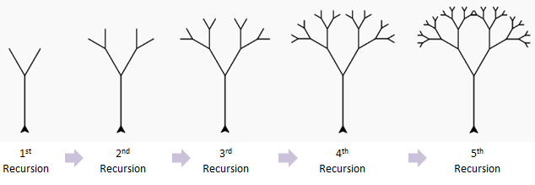
Counting the branches of a tree
The sum of the cross-sectional area of all tree branches above a branching point at any height is equal to the cross-sectional area of the trunk or the branch immediately below the branching point [1]. ... This is known asLeonardo da Vinci's rule, or the area-preservingrule
Notes:
https://journals.plos.org/plosone/article?id=10.1371/journal.pone.0093535

Slide 16
Let’s code again
Let’s do the factorial function recursively
What is the complexity of the algorithm?
Now let’s do the Fibonacci numbers

Slide 17
Printing Stars
Code the printStar(int n) function
void printStars(int n){ for(int i= 1; i <=n; i++) { print(“*”) } }
It is possible to write a recursive version of this function
It should not have any loops
We use the principles of recursion, using a base case and a recursive case

Slide 18
Consider the following recursive function
int mistery(int n){ if(n < 10 ) { return n; } else { int a = n/10; int b = n%10; return mystery(a + b); } }
What is the result of mystery(648) ?
A. 8 B. 9 C. 54 D. 72 E. 648
Notes:
B

Slide 19
Divide and conquer
Going back to the sort problem, let’s use the divide-and-conquer approach
Divide-and-conquer is an algorithm design technique.
Divide the problem, conquer the subproblems and combine the solutions

Slide 20
Coding the power function
Code a function that receives a number and an exponential to do the power function.

Slide 21
The call stack
What is going on inside?
// first call: 3, 4 public static int power(int base, int exp){
if(base == 1){
//base
return base;
} else if(exp == 0){
//base
return 1;
}else{
//recursive case
return base * power(base, exp -1);
}
}
// second call: 3, 4 public static int power(int base, int exp){
if(base == 1){
//base
return base;
} else if(exp == 0){
//base
return 1;
}else{
//recursive case
return base * power(base, exp -1);
}
}
// third call: 3, 4 public static int power(int base, int exp){
if(base == 1){
//base
return base;
} else if(exp == 0){
//base
return 1;
}else{
//recursive case
return base * power(base, exp -1);
}
}

Slide 22
Recursion Preconditions
A Precondition is something the code assumes to be true when received as an input
It can be documented and let the caller handle the validation
//returns base ^exp // Precondition: exp >=0 int power(int base, int exp)
However, documenting a precondition does not solve the problem and it is recommended you handle the situation in some way
Example: What happens if the caller of the power function passes a negative exponential value regardless of the comments in the code?

Slide 23
Throwing exceptions
When a value is received in a method and the code does not know how to handle it, it is better to throw an exception
An exception will crash the program, unless it’s handled by the caller
However, why is it necessary to have the program crash?

Slide 24
Quick Riddle
int func (int n)
{
int result;
if (n == 1)
return 1;
result = func (n - 1);
return result;
}
What does this function return?

Slide 25
Tips and Tricks
The palindrome problem
A palindrome is a word or sentence that reads the same forward or backwards
Example: Anita Lava La Tina
Write a program that determines whether a String is a palindrome or not, using recursion
Notes:
Talk about recursion with return

Slide 26
Print Binary
Write a program that writes the binary of a given decimal number
public void printBinary(int n){
.
.
.
}

Slide 27
Reverse Lines
Write a recursive function that accepts a string and prints the words of that string in reverse order
Example input String:
How are you doing?
Expected output:
?gniod uoy era woH

Slide 28
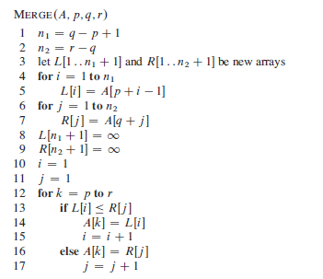
Merge Sort

Slide 29
Merge Sort
The merge sort follows the divide-and-conquer paradigm
The recursion base case is when the sequence to be sorted has length 1
The key operation of the algorithm is the merging of two sorted sequences in the “combine” step
We merge by calling an auxiliary procedure MERGE*A,p,q,r), where A is an array and p, q, andr are indices into the array such that p q<r. The procedure assumes that the subarrays AŒp ::q and AŒq C1::rare in sorted order

Slide 30
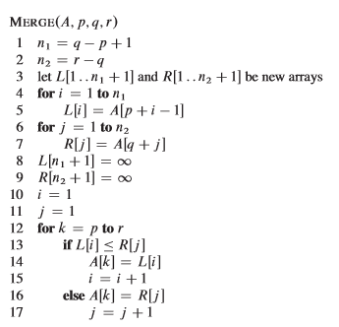
Merge Sort
The merge procedure takes O(n), where n = r - p - 1 is the total number of elements being merged

Slide 31
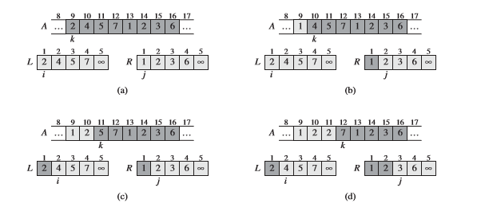
Merge Sort - Graphic Representation

Slide 32
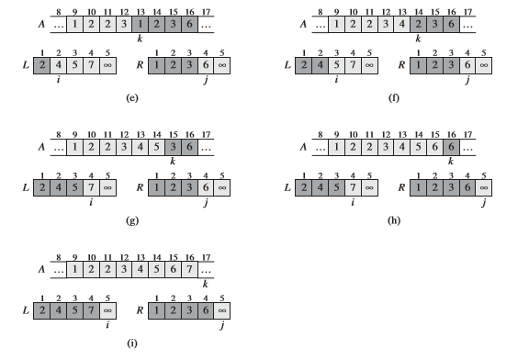
Merge Sort - Graphic Representation

Slide 33
The Maximum Sub-Array Problem
See section 4.1 of Cormen’s book

Slide 34
End of presentation

